Slide 1
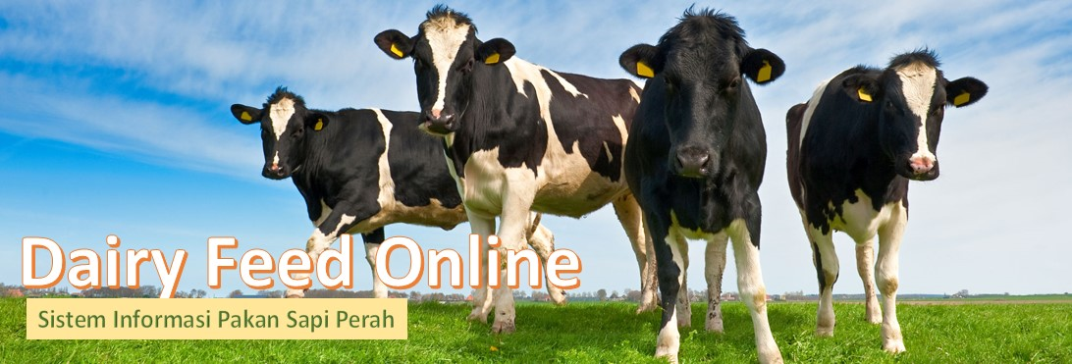
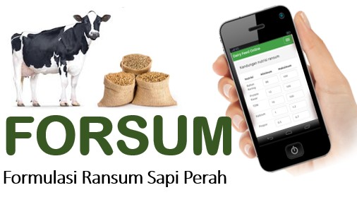
FORSUM Online
Ration Formulation
using Dairy Feed Online
Dairy Feed Online – http://dairyfeed.ipb.ac.id
© 2017 Dairy Feed Online – Dairy Feed Information System

Slide 2
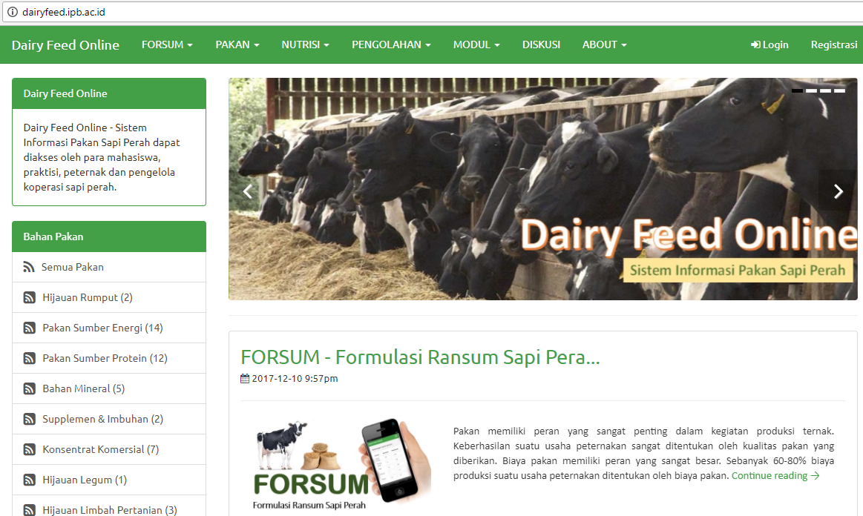
Dairy Feed Online

Slide 3
What is FORSUM Online ?
FORSUM Online is an web based application for ration formulation for dairy cattle of ruminant using local feed ingredients

Slide 4
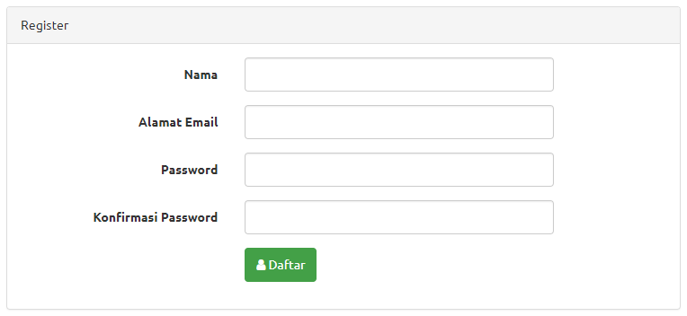
How is to registration ?
Click Registration
Entry user name
Entry email address
Entry Password
Re-entry Password

Slide 5
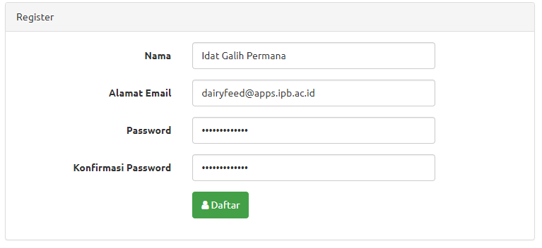
How is to registration ?
Example registration form:

Slide 6
Step by Step Feed Formualtion

Slide 7
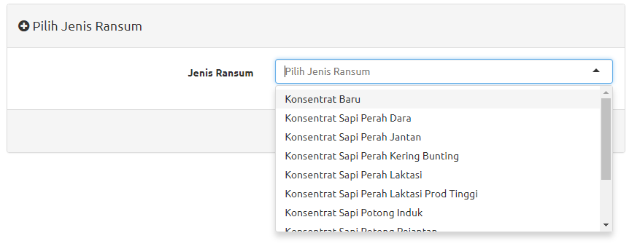
1. Type of Ration
Choose Menu FORSUM and Sub Menu FORMULASI RANSUM
Choose type of Ration:
Concentrate of dairy cattle (Konsentrat Sapi Laktasi)
Concentrate of heifer (Konsentrat Sapi Dara)
Concentrate of Bull (Konsentrat Sapi Jantan)
Etc

Slide 8
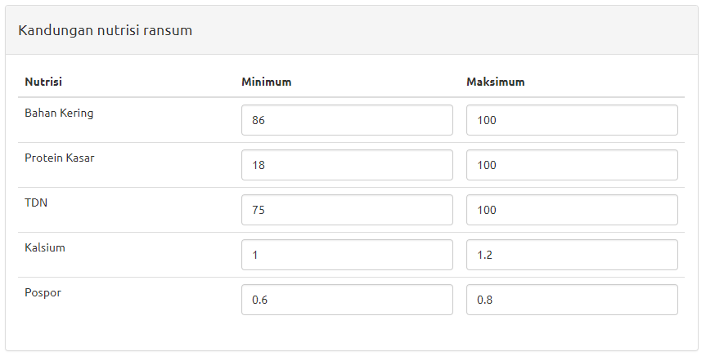
2. Entry the nutrient requirement
Entry the nutrient requirement/restriction of MINIMUM and MAXIMUM for each nutrient or use nutrient standard.

Slide 9
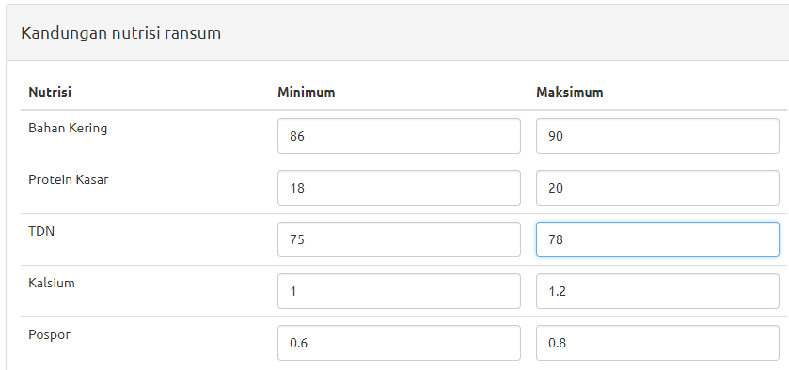
Nutrient restrictions

Slide 10
3. Choose Feed Ingredient for the Ration
Click “Pilih Bahan Pakan” (Choose Ingreidents), then choose:
Native grass (Rumput Lapang)
Naper grass (Rumput Gajah)
Corn (Jagung), …. etc
Click “Tambah Pakan” (Add Ingedient), for Add other feed ingredients
Click ”Hapus” (Delete) for delete a feed ingredient
Delete Feed Ingredient
Choose Feed Ingredient

Slide 11
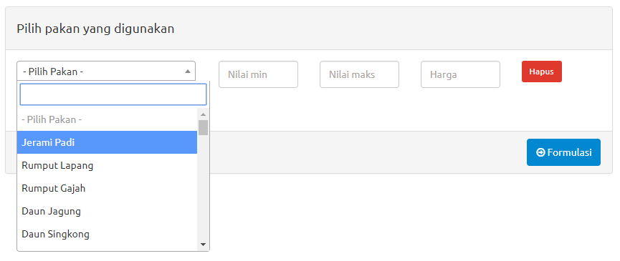
Choose Feed Ingredients
Choose Feed Ingredient

Slide 12
Example: List of Feed Ingredients
Bahan Pakan | Min | Max | Harga (Rp/kg)
Jagung | 10 | 40 | 3,000
Bungkil Kedelai | - | 30 | 6,500
Bungkil Kelapa | - | 30 | 2.750
Bungkil Sawit | - | 20 | 1,400
Dedak Padi Halus | - | 30 | 1,800
Onggok | - | 30 | 2,200
Kapur | - | 2 | 500
Dicalsium Phospat | - | 1.5 | 20,000

Slide 13
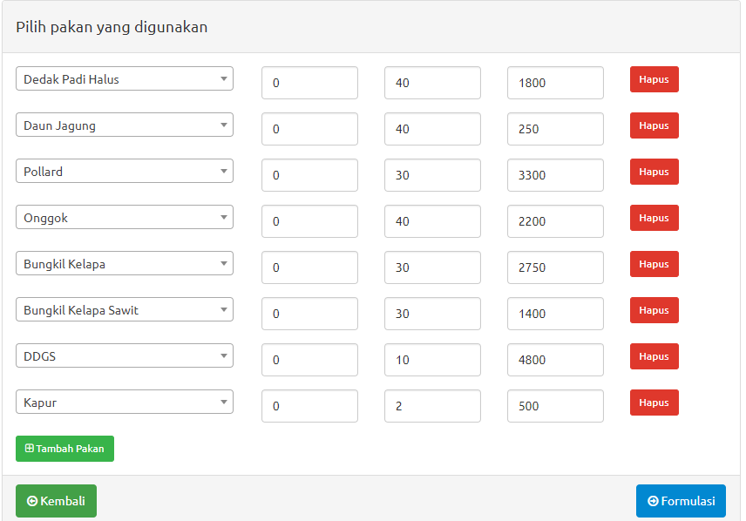
4. Ration Formulation
When all the feed ingredients are chosed than click “FORMULASI” (Formulation)
FORMULASI

Slide 14
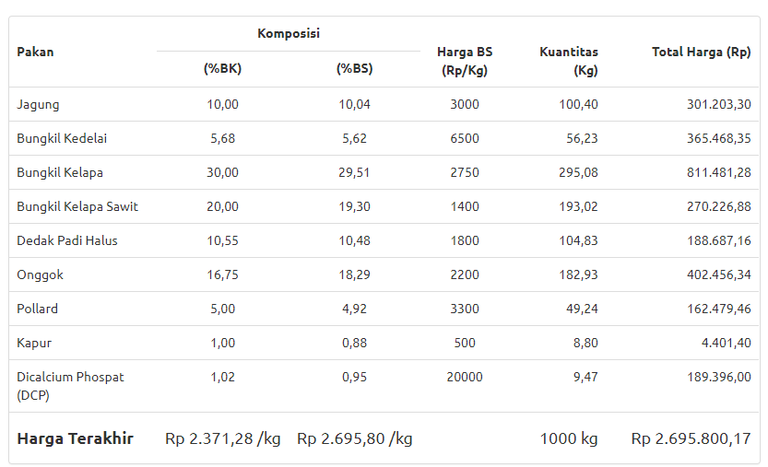
5. Result of Ration
Ration Composition

Slide 15
Ration Composition
In Dry Matter Composition
In As Feed Composition

Slide 16
Ration Composition
Price per kg DM
Price per kg As Feed
Kg ration totsl
Ration Cost

Slide 17
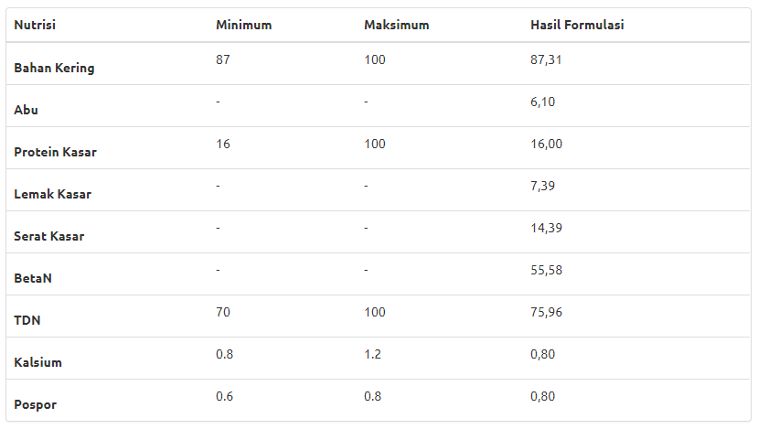
Nutrient Composition of the Ration
In Dry Matter (DM) Composition

Slide 18
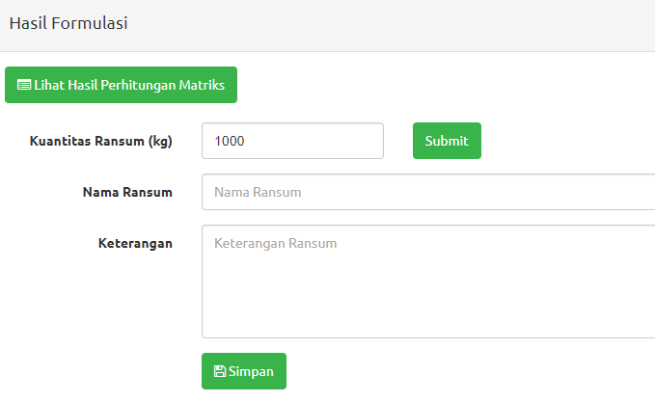
6. Save the File
Click SIMPAN (Save) to save the file of ration
Entry the quantity of ration (kg), Name of Ration and Notes
Then Click SUBMIT
Quantity of Ration
Quantity, Name of Ration and NotesRansum
Save File

Slide 19
Questions & Answers

Slide 20
What is FORSUM ?
FORSUM or Formulation Ransum is a web or android based program or application that can be used in formulating ration of dairy cattle or ruminant based on Linear Program (LP)
FORSUM can calculate rations using locally available feeding material and the lowest price

Slide 21
What rations can be made?
Various types of rations and ruminant concentrate can be formulated with this application, namely dairy cows, dairy goats, beef cattle, meat goats and sheep.

Slide 22
Is to use FORSUM the user must register?
Yes. To use FORSUM the user must register by writing the email address and create a password on the Registration menu. By registering, users can access a variety of local feed ingredients in different regions.
Users can do formulation of rations, save the rations that have been made.

Slide 23
How about step by step ration formulation?
First the user must determine the type of ration that is made by selecting the type of ration contained in the menu Options Type of Ration.
The user checks the nutrient requirements that match the type of ration. Users can fill the limits of nutrient requirements as needed.
Furthermore, the user selects the ingredients of feed in the database, filling the price according to their respective locations as well as entering the Min and Max limits of feed ingredients.
If all data is filled, click Formulation button. The ration will appear if the formulation is appropriate.
If necessary, the user can re-edit to add feed ingredients, reduce feed ingredients, edit the restrictions on the use of feed ingredients, edit the nutritional requirements restrictions, and re-do the formulation
If the ration is considered appropriate, then the ration can be SAVE and given a name.

Slide 24
Why sometimes when the result formulation "is not feasible or not optimal”?
When the formulation result is "not feasible or not optimal" there are several causes:
the feed material used is not sufficient nutrient needs,
many constraints on feed ingredients, or
restrictions on the use of feed ingredients or nutrients are too strict.

Slide 25
What to do if "not feasible or not optimal"?
Adding other feed ingredients for more choices so the computer can do the optimization. The more feed ingredients are used, the higher the chance of achieving optimal ration.
Reduce the restriction of feed ingredients, both upper limit (Max) and lower limit (Min).
If possible and still considered reasonable do decrease the limitation of nutrient requirement.

Slide 26
Why sometimes comes a message: Whoops, looks like something went wrong?
If the statement appears there are several possibilities:
You have not included the feed price,
Session login is up, meaning you have to login again, or
Internet connection is too slow or disconnected

Slide 27
Thank you
Dairy Feed Online – http://dairyfeed.ipb.ac.id
Dairy Expert:
Dr. Ir. Idat Galih Permana, MSc.Agr.
Email: permana@apps.ipb.ac.id
HP. 081 380 263 993

